Slide 1
Operating Systems
Razi Uddin
Lecture # 16

Slide 2


Shared Memory

Slide 3
Shared Memory
Typically, a shared-memory region resides in the address space of the process creating the shared memory segment.
Other processes that wish to communicate using this shared-memory segment must attach it to their address space.
Recall that, normally, the operating system tries to prevent one process from accessing another process’s memory.
Shared memory requires that two or more processes agree to remove this restriction.
They can then exchange information by reading and writing data in the shared areas.
The form of the data and the location are determined by these processes and are not under the operating system’s control.
The processes are also responsible for ensuring that they are not writing to the same location simultaneously.

Slide 4
Process Synchronization
Concurrent processes or threads often need access to shared data and shared resources.
If there is no controlled access to shared data, it is often possible to obtain an inconsistent state of this data.
Maintaining data consistency requires mechanisms to ensure the orderly execution of cooperating processes, and hence various process synchronization methods are used.

Slide 5
producer-consumer problem
A producer process produces information that is consumed by a consumer process. For Example compiler and assembler.
The producer-consumer problem also provides a useful metaphor for the client-server paradigm.
We generally think of a server as a producer and a client as a consumer.
For example, a web server produces (that is, provides) web content such as HTML files and images, which are consumed (that is, read) by the client web browser requesting the resource.
Producer–consumer problem uses shared memory. To allow producer and consumer processes to run concurrently, we must have available a buffer of items that can be filled by the producer and emptied by the consumer.
This buffer will reside in a region of memory that is shared by the producer and consumer processes.

Slide 6
producer-consumer problem
Two types of buffers can be used:
Bounded- Buffer—assumes a fixed buffer size. (consumer must wait if the buffer is empty, and the producer must wait if the buffer is full)
Un-Bounded Buffer—places no practical limit on the size of the buffer.(consumer may have to wait for new items, but the producer can always produce new items.)

Slide 7
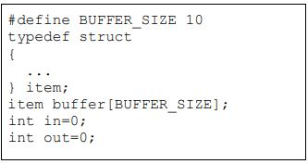
producer-consumer problem

Slide 8
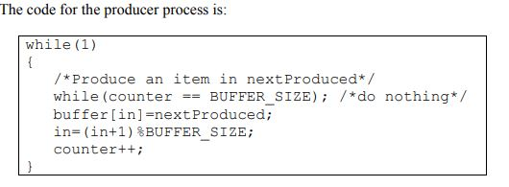
producer-consumer problem

Slide 9
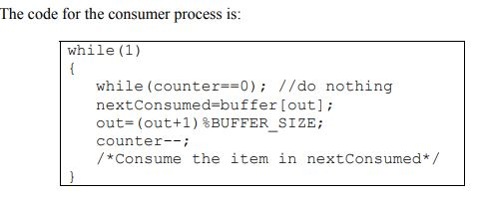
producer-consumer problem

Slide 10
producer-consumer problem
Problem—Suppose that the value of the counter is 5, and that both the producer and the consumer execute the statement counter++ and counter- - concurrently.
Following the execution of these statements the value of the counter maybe 4,5, or 6.
The only correct result of these statements should be counter= =5, which is generated if the consumer and the producer execute separately.

Slide 11
producer-consumer problem
A situation like this, where several processes access and manipulate the same data concurrently and the outcome of the manipulation depends on the particular order in which the access takes place, is called a race condition. To guard against such race conditions, we require synchronization of processes.

Slide 12
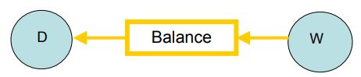
Bank Transaction Example

Slide 13
Critical Section—A piece of code in a cooperating process in which the process may updates shared data (variable, file, database, etc.).

Slide 14
Critical Section Problem
Serialize executions of critical sections in cooperating processes.
When a process executes code that manipulates shared data (or resource), we say that the process is in its critical section (for that shared data).
The execution of critical sections must be mutually exclusive: at any time, only one process is allowed to execute in its critical section (even with multiple processors).
So each process must first request permission to enter its critical section.
The section of code implementing this request is called the entry section.
The remaining code is the remainder section.

Slide 15
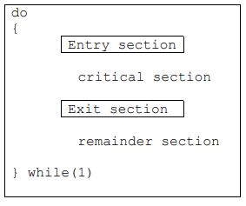
Critical Section Problem

Slide 16
Critical Section Problem
There can be three kinds of solutions to the critical section problem:
Software based solutions
Hardware based solutions
Operating system based solution

Slide 17
Solution to Critical Section Problem
A solution to the critical section problem must satisfy the following three requirements:
Mutual Exclusion—If process Pi is executing in its critical section, then no other process can be executing in its critical section.
Progress—If no process is executing in its critical section and some processes wish to enter their critical sections, then only those processes that are not executing in their remainder section can participate in the decision on which will enter its critical section next, and this selection cannot be postponed indefinitely.
Bounded Waiting—There exists a bound on the number of times that other processes are allowed to enter their critical sections after a process has made a request to enter its critical section and before that request is granted.

Slide 18
Assumptions
While formulating a solution, we must keep the following assumptions in mind:
Assume that each process executes at a nonzero speed.
No assumption can be made regarding the relative speeds of the N processes.

Slide 19
2-Process Solutions to the Critical Section Problem
The processes are P₀ and P₁.
When presenting P_{i} means P₀, and we use P_{j} to denote the other process i.e. P₁.
An assumption is that the basic machine language instructions such as load and store are executed atomically, that is an operation that completes in its entirety without interruption.

Slide 20
2-Process Solutions to the Critical Section Problem
do
{
Critical Section
Remainder Section
}while(1)
While(turn !=i);
turn =j;
Algorithm 1
For P_{i}

Slide 21
Algorithm 1
The processes share a common integer variable turn initialized to 0 or 1.
If turn = = i, then process Pi is allowed to execute in its critical section.
This solution ensures mutual exclusion, that is only one process at a time can be in its critical section.
However it does not satisfy the progress requirement, since it requires strict alternation of processes in the execution of the critical section.
For example, if turn= =0 and P1 is ready to enter its critical section, P1 cannot do so even though P0 may be in its remainder section.
The bounded wait condition is satisfied though because there is an alternation between the turns of the two processes.

Slide 22
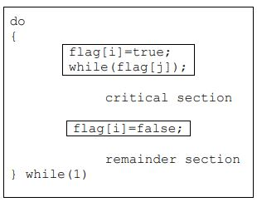

Algorithm 2 For P_{i}

Slide 23
Algorithm 2
In algorithm two, the variable turn is replaced with an array boolean flag[2]
whose elements are initialized to false.
If flag is true for a process that indicates that the process is ready to enter its critical section.
In this algorithm Pi sets flag[i]= true signaling that it is ready to enter its critical section.
Then Pi checks to verify that process Pj is not also ready to enter its critical section.
If Pj were ready, then Pi would wait until Pj had indicated that it no longer needed to be in the critical section (that is until flag[j]=false).
At this point Pi would enter the critical section.

Slide 24
Algorithm 2
On exiting the critical section, Pi would set flag[i]=false allowing the other process to enter its critical section.
In this solution, the mutual exclusion requirement is satisfied.
Unfortunately the progress condition is not met; consider the following execution sequence:
T0: P0 sets flag[0]= true
T1: P1 sets flag[1]= true
Now both the processes are looping forever in their respective while statements.

Slide 25
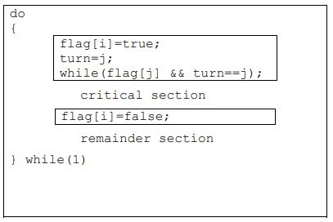
Algorithm 3 For P_{i}

Slide 26
Algorithm 3
The processes share two variables:
boolean flag[2];
int turn;
The boolean array of ‘flag’ is initialized to false, whereas ‘turn’ maybe 0 or 1
To enter its critical section, Pi sets flag[i] to true, and sets ‘turn’ to j, asserting that if the other process wishes to enter its critical section, it may do so.
If both try to enter at the same time, they will attempt to set ‘turn’ to i and j. However, only one of these assignments will last, the other will occur but be overwritten instantly.
Hence, the eventual value of ‘turn’ will decide which process gets to enter its critical section.

Slide 27
Algorithm 3
To prove mutual exclusion, note that Pi enters its critical section only if either flag[j]=false or turn=i.
Also, if both processes were executing in their critical sections at the same time, then flag[0]= = flag[1]= = true.
These two observations suggest that P0 and P1 could not have found both conditions in the while statement true at the same time, since the value of ‘turn’ can either be 0 or 1.
Hence only one process say P0 must have successfully exited the while statement.
Hence mutual exclusion is preserved.

Slide 28
Algorithm 3
To prove bounded wait and progress requirements, we note that a process Pi can be prevented the critical section only if it is stuck in the while loop with the condition flag[j]= =true and turn=j.
If Pj is not ready to enter the critical section, then flag[j]=flase and Pi can enter its critical section.
If Pj has set flag[j]=true and is also executing its while statement then either turn=i or turn=j.
If turn=i then Pi enters its critical section, otherwise Pj.
However, whenever a process finishes executing in its critical section, lets assume Pj, it resets flag[j] to false allowing Pi to enter its critical section.
If Pj resets flag[j]=true, then it must also set ‘turn’ to i, and since Pi does not change the value of ‘turn’ while executing in its while statement, Pi will enter its critical section (progress) after at most one entry by Pj (bounded waiting).

Slide 29
N-Process Critical Section Problem
In this section we extend the critical section problem of two processes to include n processes. Consider a system of n processes (Po, P1 …… Pn-1). Each process has a segment of code called a critical section in which the process may be changing common variables, updating a table, writing a file and so on. The important feature of the system in that, when one process enters its critical section, no other process is allowed to execute in its critical section. Thus the execution of critical sections by the processes is mutually exclusive in time. The critical section problem is to design a protocol to serialize executions of critical sections. Each process must request permission to enter its critical section. Many solutions are available in the literature to solve the N-process critical section problem. We will discuss a simple and elegant solution, known as the Bakery algorithm.

Slide 30
The Bakery Algorithm
The bakery algorithm is due to Leslie Lamport and is based on a scheduling algorithm commonly used in bakeries, ice-cream stores, and other locations where order must be made out of chaos.
On entering the store, each customer receives a number.
The customer with the lowest number is served next.
Before entering its critical section, process receives a ticket number.
Holder of the smallest ticket number enters its critical section.
Unfortunately, the bakery algorithm cannot guarantee that two processes (customers) will not receive the same number.

Slide 31
The Bakery Algorithm
In the case of a tie, the process with the lowest ID is served first.
If processes Pi and Pj receive the same number, if i < j, then Pi is served first; else Pj is served first.
The ticket numbering scheme always generates numbers in the increasing order of enumeration; i.e., 1, 2, 3, 4, 5 ...
Since process names are unique and totally ordered, our algorithm is completely deterministic.

Slide 32
The Bakery Algorithm
The common data structures are:
boolean choosing [n];
int number[n];
Initially these data structures are initialized to false and 0, respectively.
The following notation is defined for convenience:
(ticket #, process id #)
(a,b) < (c,d) if a<c or if a==c and b<d
max(a0, …an-1 ) is a number, k, such that k>= a_{i} for i=0,…n-1

Slide 33

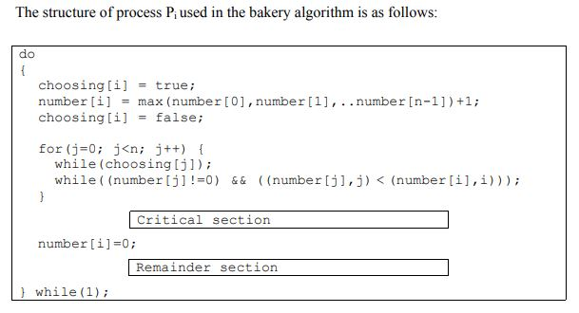
The Bakery Algorithm

Slide 34
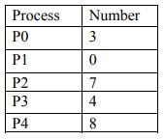
The Bakery Algorithm

Slide 35
The Bakery Algorithm
The following table shows the status of all the processes as they execute the ‘for’ loops in their entry sections.
The gray cells show processes waiting in the second while loops in their entry sections.
The table shows that P0 never waits for any process and is, therefore, the first process to enter its critical section,
while all other processes wait in their second while loops for j = = 0, indicating that they are waiting for P0 to get out of its critical section and then they would make progress (i.e., they will get out the while loop, increment j by one, and continue their execution).

Slide 36
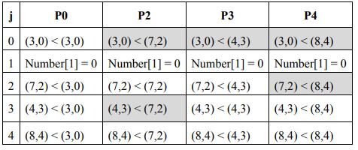
The Bakery Algorithm
1
3
2
4

Slide 37
The Bakery Algorithm
You can make the following observations by following the Bakery algorithm closely with the help of the following table:
P1 not interested to get into its critical section ⇒ number[1] is 0
P2, P3, and P4 wait for P0
P0 gets into its CS, get out, and sets its number to 0
P3 get into its CS and P2 and P4 wait for it to get out of its CS
P2 gets into its CS and P4 waits for it to get out
P4 gets into its CS
Sequence of execution of processes: <P₀,P₃,P₂,P₄>

